Slide 1
English grade 3
Stand up!
Unit 6
Lesson 1

Slide 2
Warm-up

Slide 3
Trò chơi
HÁI TÁO
Notes:
Ms Huyền Phạm - 0936.082.789 – YOUTUBE: MsPham. Facebook: Dạy và học cùng công nghệ.

Slide 4
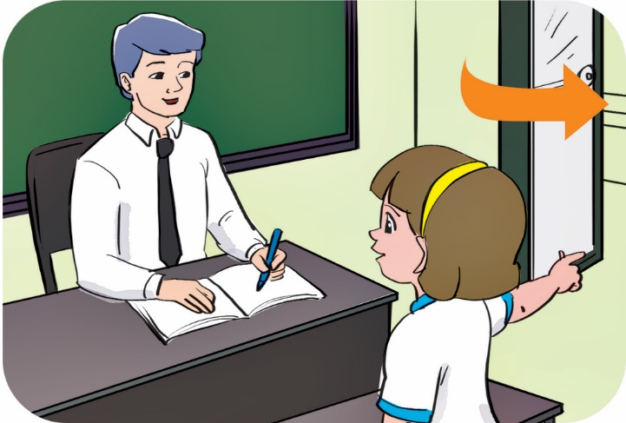
May I come in?
A
May I go out?
B
May I sit down?
Yes, you can.
C
Notes:
Ms Huyền Phạm - 0936.082.789 – YOUTUBE: MsPham. Facebook: Dạy và học cùng công nghệ.

Slide 5
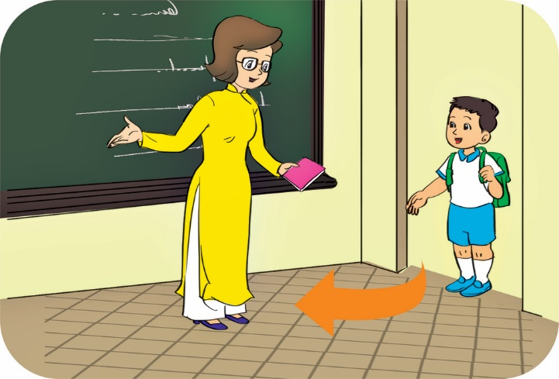
May I come in?
A
May I come out?
B
Come in, please.
Yes, you can.
C
Notes:
Ms Huyền Phạm - 0936.082.789 – YOUTUBE: MsPham. Facebook: Dạy và học cùng công nghệ.

Slide 6
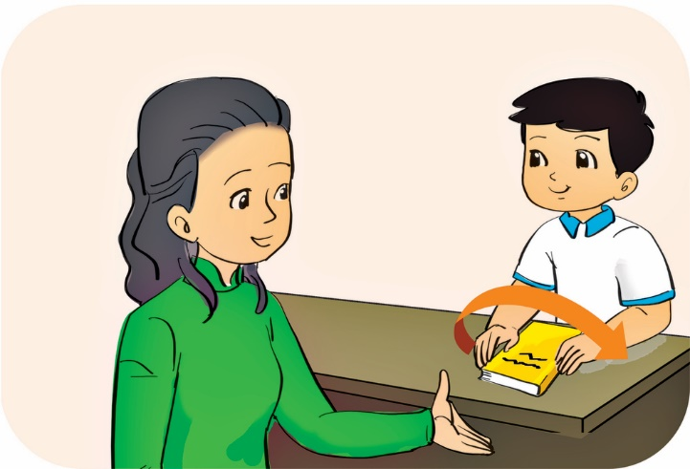
Yes, please.
A
No, you can’t.
B
May I open my book?
Yes, you can.
C
Notes:
Ms Huyền Phạm - 0936.082.789 – YOUTUBE: MsPham. Facebook: Dạy và học cùng công nghệ.

Slide 7
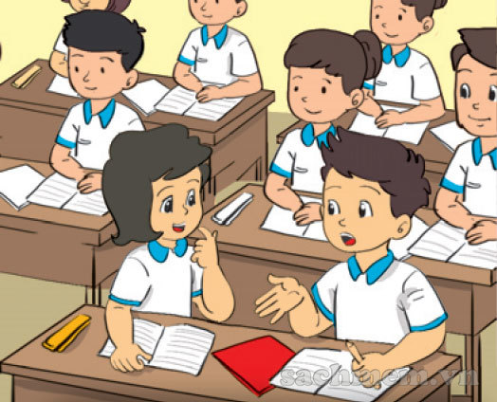
Yes, you can’t.
A
No, you can’t.
B
No, thanks.
May I speak?
C
Notes:
Ms Huyền Phạm - 0936.082.789 – YOUTUBE: MsPham. Facebook: Dạy và học cùng công nghệ.

Slide 8
ok
A
too
B
please
Stand up, _______.
C
Notes:
Ms Huyền Phạm - 0936.082.789 – YOUTUBE: MsPham. Facebook: Dạy và học cùng công nghệ.

Slide 9
_____, please.
Don’t quiet
A
Be not quiet.
B
Be quiet
C
Notes:
Ms Huyền Phạm - 0936.082.789 – YOUTUBE: MsPham. Facebook: Dạy và học cùng công nghệ.

Slide 10
Be
A
_____ talk.
Don’t
B
May I
C
Notes:
Ms Huyền Phạm - 0936.082.789 – YOUTUBE: MsPham. Facebook: Dạy và học cùng công nghệ.

Slide 11
May I stand in?
A
May I stand out?
Yes, you can.
B
May I stand up?
C
Notes:
Ms Huyền Phạm - 0936.082.789 – YOUTUBE: MsPham. Facebook: Dạy và học cùng công nghệ.

Slide 12
please
A
Come here, _____.
May I
B
ok
C
Notes:
Ms Huyền Phạm - 0936.082.789 – YOUTUBE: MsPham. Facebook: Dạy và học cùng công nghệ.

Slide 13
1. Listen and repeat

Slide 14
2. Listen and write.
____________
_____________

Slide 15
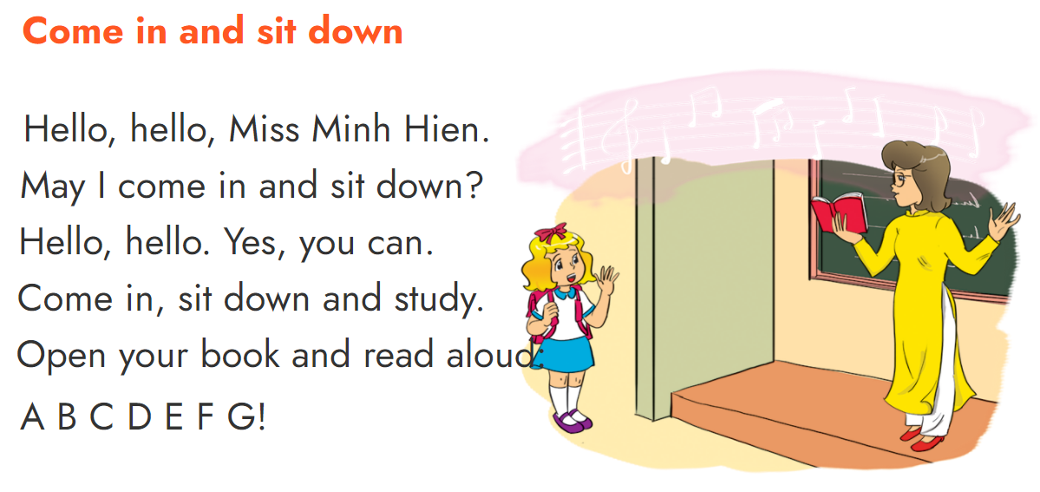
2. Let’s sing.

Slide 16
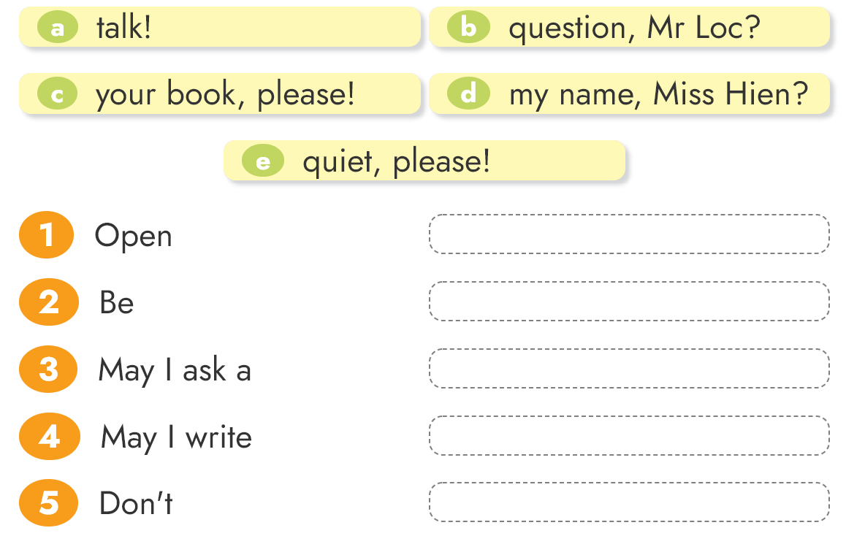
4. Read and match

Slide 17
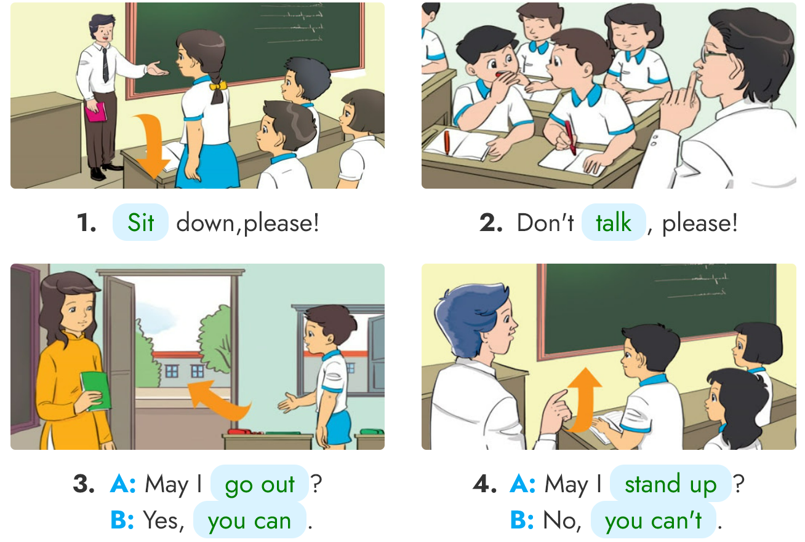
3. Look, read and write
____
____
______
______
______
______

Slide 18
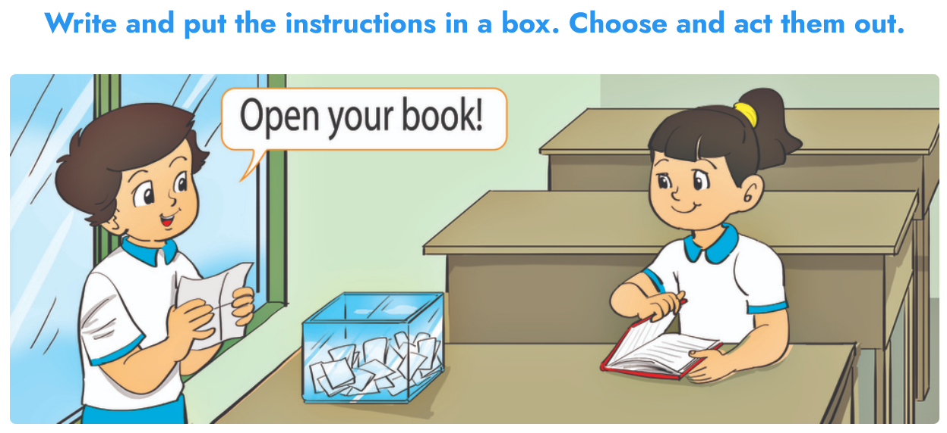
6. Project

Slide 19
THANK YOU!
Welcome to join with me!

